Slide 1




ENERGY CONSUMPTION TREND ANALYSIS USING POWER BI
Student details
NAME-Somagutta pavan kumar reddy
AICTE STUDENT ID: STU662cbd5fde0101714208095
Internship ID : INTERNSHIP_173070615967287aef12823
G-mail:somaguttapavankumarreddy@gmail.com
Email- somaguttapavankumarreddt@gmail.com

Slide 2

AIM:
The aim of this project is to analyze trends in water, gas, and electricity consumption across different buildings over monthly and yearly basis, inefficiencies, and opportunities for cost savings through dashboards using Power BI.
GOAL
Source :
www.freepik.com/

Slide 3
Learning Objectives
To compare the energy consumption across different buildings.
To identify peak consumption periods for each type of energy.
To calculate the total cost associated with energy consumption using rate data.
GOAL
Source :
www.freepik.com/

Slide 4
Tools and Technology used :
Microsoft Excel: For organizing and cleaning raw data.
Power BI: For creating visualizations and dashboards to analyze trends.

Slide 5
Problem Statement:
The dashboard should address the following objectives:
Correlate building size with total energy consumption.
Identify the building with the most consistent energy usage across months.
Compare energy consumption patterns for residential and commercial buildings.
Determine peak electricity consumption hours for each building.
Analyze annual growth rate for energy sources(water,gas,electricity).
Highlight top energy-saving oportunities for each building.
identify the most water-intessive month and underlying reasions.
Evaluate energy consumpation per occupant and per square meter a cross building.
Deleveop a interactive power bi dashboard to analyse energy consumption data for business providing insighrs into total costs ,unit comsumption and trends across different energy types.
Develop a Power BI dashboard to analyze and compare energy consumption and costs across various departments or business units, helping identify energy-intensive areas.
Build an interactive dashboard to analyze hourly, daily, and monthly peak energy usage, enabling businesses to optimize operations during peak demand hours.
Develop a Power BI dashboard to compare energy costs, consumption, and trends across different energy types, helping businesses prioritize cost-effective sources.

Slide 6
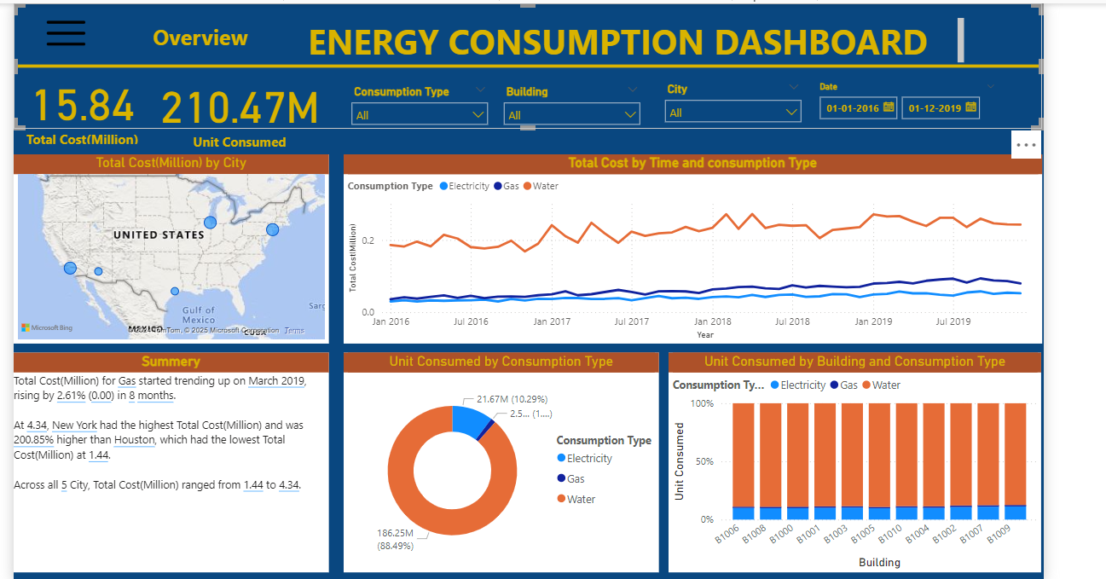

Slide 7
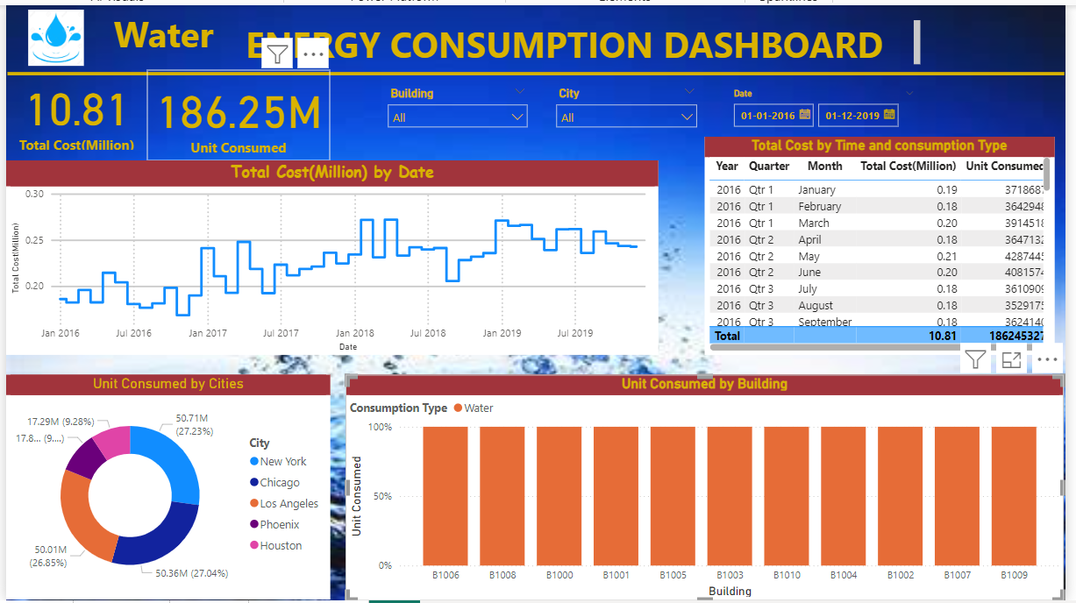

Slide 8
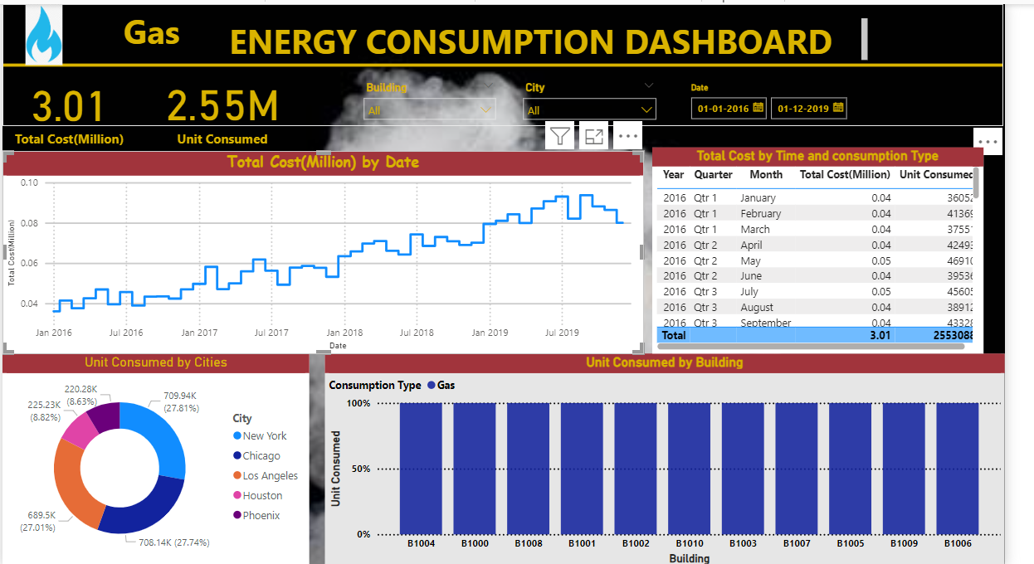

Slide 9
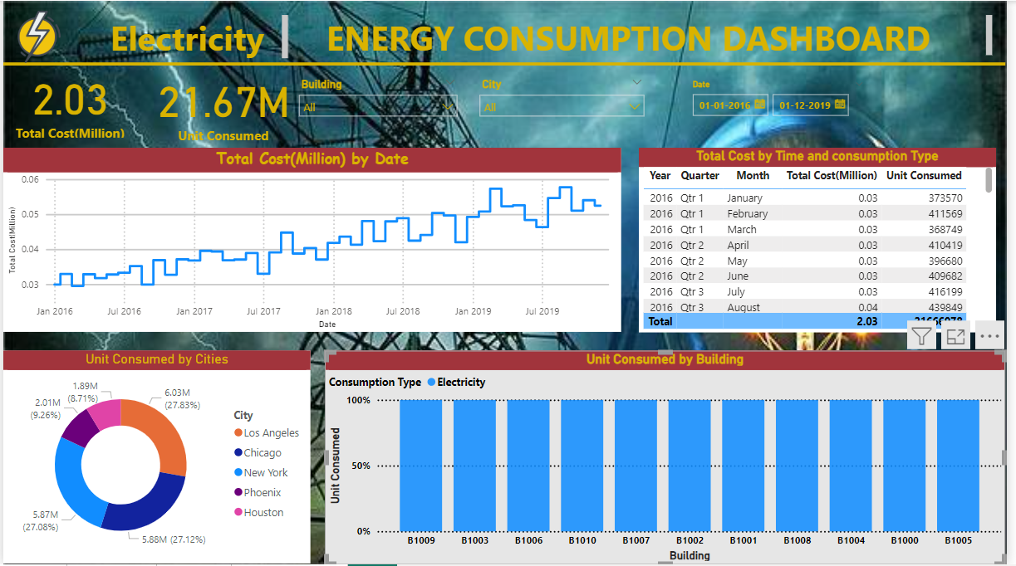

Slide 10
Conclusion:
The energy consumption dashboard created through Power BI offers a comprehensive view of energy usage (electricity, gas, and water) across multiple buildings. It enables a data-driven approach to identifying inefficiencies, tracking trends, and recognizing seasonal or operational patterns in energy use. The visual representation of data provides clarity on key metrics such as peak consumption periods, cost breakdowns, carbon footprints, and the impact of weather conditions and occupancy rates on energy usage.
Through this analysis, actionable insights can be derived, such as targeted energy-saving measures, optimized resource allocation, and prioritization of retrofitting or upgrades in older buildings. Additionally, the dashboard highlights opportunities to implement sustainable practices, such as adjusting peak usage behaviors, improving energy-efficient lighting or HVAC systems, and reducing water wastage.
Ultimately, the Power BI dashboard empowers decision-makers to enhance energy efficiency, reduce operating costs, and align with long-term sustainability goals, ensuring better resource management and a reduced environmental impact.

